Slide 1
Software Fundamentals
Prepared By
Mehedi Hasan Imran
Lecturer, BAUET
Dept. of ICE

Slide 2
Software
A set of instructions that achieve a single outcome are called program or procedure. Many programs functioning together to do a task make a software.
For example, a word-processing software enables the user to create, edit and save documents. A web browser enables the user to view and share web pages and multimedia files. There are two categories of software −
System Software
Application Software
Utility Software

Slide 3
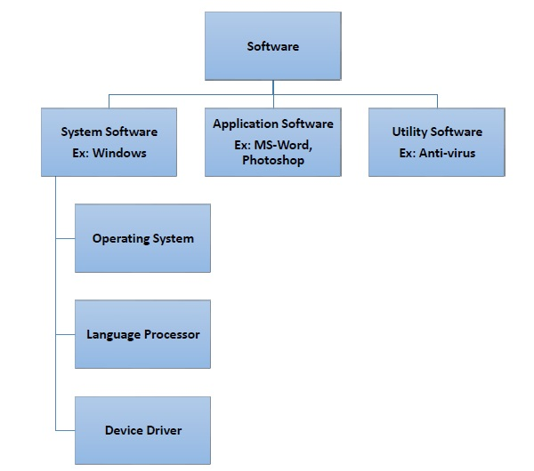

Slide 4
System Software
Software required to run the hardware parts of the computer and other application software are called system software. System software acts as interface between hardware and user applications. An interface is needed because hardware devices or machines and humans speak in different languages.
Machines understand only binary language i.e. 0 (absence of electric signal) and 1 (presence of electric signal) while humans speak in English, French, German, Tamil, Hindi and many other languages. English is the pre-dominant language of interacting with computers. Software is required to convert all human instructions into machine understandable instructions. And this is exactly what system software does.
Based on its function, system software is of four types −
Operating System
Language Processor
Device Drivers

Slide 5
Operating System
System software that is responsible for functioning of all hardware parts and their interoperability to carry out tasks successfully is called operating system (OS). OS is the first software to be loaded into computer memory when the computer is switched on and this is called booting. OS manages a computer’s basic functions like storing data in memory, retrieving files from storage devices, scheduling tasks based on priority, etc.
Application Software
A software that performs a single task and nothing else is called application software. Application software are very specialized in their function and approach to solving a problem. So a spreadsheet software can only do operations with numbers and nothing else. A hospital management software will manage hospital activities and nothing else. Here are some commonly used application software −
Word processing
Spreadsheet
Presentation
Database management
Multimedia tools

Slide 6
Utility Software
Application software that assist system software in doing their work is called utility software. Thus utility software is actually a cross between system software and application software. Examples of utility software include −
Antivirus software
Disk management tools
File management tools
Compression tools
Backup tools

Slide 7
Disk Operating System
(Disk Operating System) Any operating system that supports hard drives. DOS is an acronym often used to describe MS-DOS and the Windows command line. More generally, it may be used to refer to any operating system that runs from a disk drive. Today, all operating systems can be considered disk operating systems.
MS-DOS, in full Microsoft Disk Operating System, the dominant operating system for the personal computer (PC) throughout the 1980s
MS-DOS Operating system
The advantages of MS-DOS Operating System are as follows −
MS-DOS is a lightweight system and it allows direct access to all hardware with the help of the command line.
This operating system is very lightweight.
It also does not support multitasking therefore there is less overhead and less latency.
MS_DOS boots the system faster than any other operating system.

Slide 8
The disadvantages of MS-DOS Operating System are as follows −
It has a command line user interface therefore it is very less user friendly.
Very few applications are supported in DOS.
It is deprecated by Microsoft that’s why no more updates will be available to MSDOS.
It does not support multitasking. So, only one application can be run on this OS at a time.

Slide 9
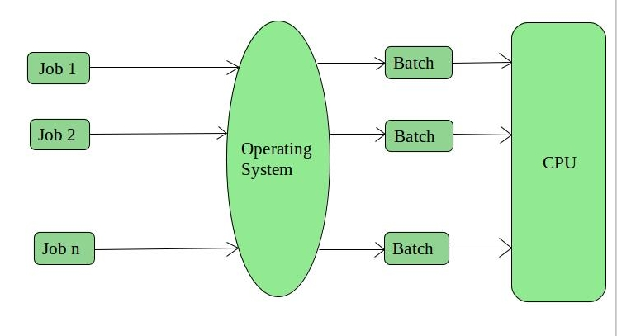
Operating System (OS)
An Operating System performs all the basic tasks like managing files, processes, and memory. Thus operating system acts as the manager of all the resources, i.e. resource manager. Thus, the operating system becomes an interface between user and machine.
Types of Operating Systems: Some widely used operating systems are as follows-
Batch Operating System – This type of operating system does not interact with the computer directly. There is an operator which takes similar jobs having the same requirement and group them into batches. It is the responsibility of the operator to sort jobs with similar needs.

Slide 10
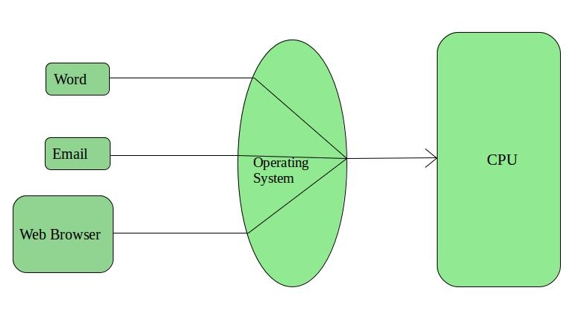
2. Time-Sharing Operating Systems – Each task is given some time to execute so that all the tasks work smoothly.
Each user gets the time of CPU as they use a single system. These systems are also known as Multitasking Systems.
The task can be from a single user or different users also. The time that each task gets to execute is called
quantum. After this time interval is over OS switches over to the next task.

Slide 11
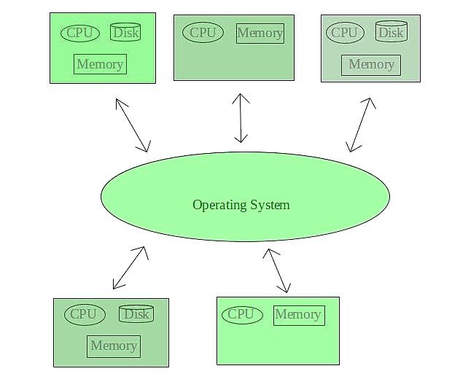
3. Distributed Operating System –
These types of the operating system is a recent advancement in the world of computer technology and are
being widely accepted all over the world and, that too, with a great pace. Various autonomous interconnected
computers communicate with each other using a shared communication network. Independent systems
possess their own memory unit and CPU. These are referred to as loosely coupled systems or distributed
systems. These system’s processors differ in size and function. The major benefit of working with these types
of the operating system is that it is always possible that one user can access the files or software which are not
actually present on his system but some other system connected within this network i.e., remote access is
enabled within the devices connected in that network.

Slide 12
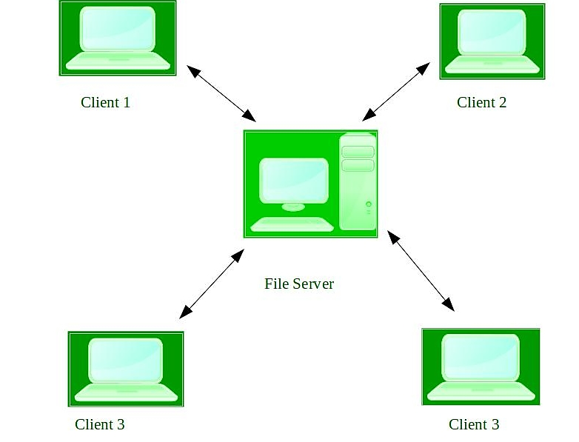
4. Network Operating System –
These systems run on a server and provide the capability to manage data, users, groups, security, applications,
and other networking functions. These types of operating systems allow shared access of files, printers,
security, applications, and other networking functions over a small private network. One more important
aspect of Network Operating Systems is that all the users are well aware of the underlying configuration, of all
other users within the network, their individual connections, etc. and that’s why these computers are popularly
known as tightly coupled systems.

Slide 13
What is a DDoS attack?
In a distributed denial-of-service (DDoS) attack, multiple compromised computer systems attack a target and cause a denial of service for users of the targeted resource. The target can be a server, website or other network resource. The flood of incoming messages, connection requests or malformed packets to the target system forces it to slow down or even crash and shut down, thereby denying service to legitimate users or systems.
Microsoft Disk Operating System (MS-DOS)
The Microsoft Disk Operating System (MS-DOS) is an operating system developed for PCs with x86 microprocessors. It is a command-line-based system, where all commands are entered in text form and there is no graphical user interface. MS-DOS was the most commonly used member of the family of disk operating systems.

Slide 14
Windows
The Windows operating system (Windows OS) refers to a family of operating systems developed by Microsoft Corporation. We look at the history of Windows OS from 1985 to present day.
The Windows operating system (Windows OS) for desktop PCs is more formally called Microsoft Windows and is actually a family of operating systems for personal computers. Windows has traditionally dominated the personal computer world, running, by some estimates, more than 75 percent of all personal computers. Beginning in the early 2000s, Windows dominance has lessened with the growth of the Linux and Mac operating systems.
Windows provides a graphical user interface (GUI), virtual memory management, multitasking, and support for many peripheral devices. In addition to Windows operating systems for personal computers, Microsoft also offers operating systems for servers and mobile devices.
Windows is also the foundation for the Microsoft Office productivity suite. Introduced in 1990 as a Windows-only family of applications for desktop computers, Office has grown to become the world’s most widely used productivity suite, with windowscentral.com reporting an estimated 1.2 billion + user worldwide as of 2016.

Slide 15
Windows 1.0 (November 20, 1985)
Windows 2.0 (December 9, 1987)
Windows 3.0 (May 22, 1990)
Windows NT 3.1 – 4.0 (July 27, 1993)
Windows 95 (August 24, 1995)
Windows 98 (June 25, 1998)
Windows 2000 ( February 17, 2000)
Windows Millennium Edition (ME) (June 19, 2000)
Windows XP (October 25, 2001)
Windows Vista (November 30, 2006 (corporate); January 30, 2007 (public))
Windows 7 ( October 22, 2009)
Windows 8 (October 26, 2012)
Windows 10 ( July 29, 2015)
Windows 11 (October 5, 2021)

Slide 16
Macintosh Operating System (Mac OS)
The Macintosh Operating System (Mac OS) is an operating system (OS) designed by Apple Inc. to be installed and operated on the Apple Macintosh series of computers. Introduced in 1984, it is a graphical user interface (GUI) based OS that has since been released as multiple different versions.
Initially, Mac OS was known as System Software.
Symbian
Symbian OS is an operating system designed for mobile devices. Symbian was the leading smartphone platform up from 2003 up until 2010 (even 2011 for Europe). After that Google's Android OS took the lead.
The core Symbian OS originally provided no user interface. Instead, it was used as the underlying base for two major smartphone UI platforms: S60 and UIQ. These can be regarded as development branches, each backed by different companies. Unlike Android OS with its different cosmetic UIs, Symbian UIs ran deeper in the code and apps written for one of these platforms were not compatible with the other directly. Visually, the S60 and the UIQ had nothing in common and UIQ was created with touchscreens in mind.

Slide 17
Unix
The Unix operating system is a set of programs that act as a link between the computer and the user.
The computer programs that allocate the system resources and coordinate all the details of the computer's internals is called the operating system or the kernel.
Users communicate with the kernel through a program known as the shell. The shell is a command line interpreter; it translates commands entered by the user and converts them into a language that is understood by the kernel. Unix is a computer Operating System which is capable of handling activities from multiple users at the same time. The development of Unix started around 1969 at AT&T Bell Labs by Ken Thompson and Dennis Ritchie.

Slide 18
Android
Android is an open source and Linux-based Operating System for mobile devices such as smartphones and tablet computers. Android was developed by the Open Handset Alliance, led by Google, and other companies.
Android offers a unified approach to application development for mobile devices which means developers need only develop for Android, and their applications should be able to run on different devices powered by Android.
iOS
IOS stands for iPhone operating system. It is a proprietary mobile operating system of Apple for its handheld. It supports Objective-C, C, C++, Swift programming language. It is based on the Macintosh OS X. After Android, it is the world’s second most popular mobile operating system. Many of Apple’s mobile devices, including the iPhone, iPad, and iPod, run on this operating system. To control the device, iOS employs a multi-touch interface, such as sliding your finger across the screen to advance to the next page or pinching your fingers to zoom in or out of the screen.

Slide 19
Word processing software
Word processing software is used to manipulate a text document, such as a resume or a report. You typically enter text by typing, and the software provides tools for copying, deleting and various types of formatting. Some of the functions of word processing software include:
Creating, editing, saving and printing documents.
Copying, pasting, moving and deleting text within a document.
Formatting text, such as font type, bolding, underlining or italicizing.
Creating and editing tables.
Inserting elements from other software, such as illustrations or photographs.
Correcting spelling and grammar.
Spreadsheet
A spreadsheet is a computer application for computation, organization, analysis and storage of data in tabular form. Spreadsheets were developed as computerized analogs of paper accounting worksheets. The program operates on data entered in cells of a table. Each cell may contain either numeric or text data, or the results of formulas that automatically calculate and display a value based on the contents of other cells. A spreadsheet may also refer to one such electronic document.

Slide 20
Presentation program
In computing, a presentation program (also called presentation software) is a software package used to display information in the form of a slide show. It has three major functions:
an editor that allows text to be inserted and formatted
a method for inserting and manipulating graphic images and media clips
a slide-show system to display the content
Device driver
More commonly known as a driver, a device driver or hardware driver is a group of files that enable one or more hardware devices to communicate with the computer's operating system. Without drivers, the computer could not send and receive data correctly to hardware devices, such as a printer.

Slide 21
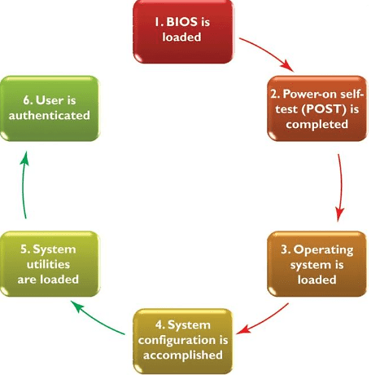
Booting Process
Booting is the process of switching on the computer and starting the operating system. 6 steps in the booting process are BIOS and Setup Program, The Power-On-Self-Test (POST), The Operating System Loads, System Configuration, System Utility Loads, and Users Authentication.

Slide 22
Step 1: BIOS and Setup Program
ROM (read-only memory): it is a permanent and unchanging memory also
BIOS (basic input/output system ): the part of the system software that includes the instructions that the computer uses to accept input and output
Load: to transfer from a storage device to memory. The ROM loads BIOS into the computer’s memory
Setup program: a special program containing settings to control hardware. Furthermore, the program can only be accessed while the BIOS information is visible.
Step 2: The Power-On-Self-Test (POST)
POST (Power-On Self-Test): a series of tests conducted on the computer’s main memory, input/output devices, disk drives, and the hard disk.
BIOS conducts Power-On-Self-Test to check the input/ output system for operability.
The computer will produce a beeping sound if any problem occurs. An error message will also appear on the monitor

Slide 23
Step 3: The Operating System (OS) Loads
BIOS searches for the operating system.
Setting in CMOS: complementary metal oxide semiconductor determines where to look for the operating system.
In this step, the operating system’s kernel is also loaded into the computer’s memory.
The operating system takes control of the computer and begins loading system configuration information.
Step 4: System Configuration
Registry: a database to store information about peripherals and software
Peripheral: a device connected to a computer
Drive: a utility program that makes peripheral devices function properly
The operating system’s registry configures the system.
In this step, drivers are also loaded into memory.

Slide 24
Step 5: System Utility Loads
System utilities are loaded into memory.
Volume control
Antivirus software
PC card unplugging utility
Step 6: Users Authentication
Authentication or user login occurs
Username
Password
The above-mentioned steps play an important role in booting a computer. After all this process, the user interface starts, enabling user interaction with the computer and its programs also.

